Slide 2
Shor’s algorithm
=> Quantum phase estimation
=> Quantum Fourier transform
=> Classical Fourier transform
=> Quantum phase kickback
=> Global phase & relative phase
=> Measurement
=> Quantum circuit
=> Period finding

Slide 3

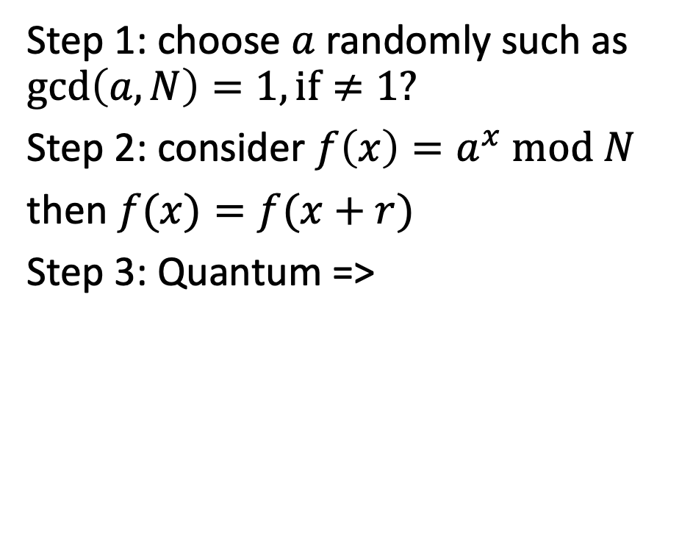






Summary
$$N=p.q$$
Step 1: choose $a$ randomly such as $\gcd\left(a,N\right)=1,if≠1?$
Step 2: consider $f\left(x\right)=a^{x} mod N$
then $f(x)=f(x+r)$
Step 3: Quantum =>
Unknown
r is even
$$gcd(a^{\frac{r}{2}}−1,N)$$
$$gcd(a^{\frac{r}{2}}+1,N)$$
$a^{r}≡1$ (mod N)
$r$ should min
$$gcd\left(a,N\right)=1,a∈(1,N)$$
$$f\left(x\right)=a^{x} mod N$$

Slide 4
1. What is Phase kickback?

Slide 5

Global phase & relative phase
Consider state $\left.|φ\right\rangle =c_{1}\left.|0\right\rangle +c_{2}\left.|1\right\rangle =r_{1}e^{iφ_{1}}\left.|0\right\rangle +r_{2}e^{iφ_{2}}\left.|1\right\rangle$
$$=e^{iφ_{1}}(\left.r_{1}|0\right\rangle +r_{2}e^{i\left(φ_{2}−φ_{1}\right)}\left.|1\right\rangle )$$
$e^{iφ_{1}}$ is vanish while conduct the measurement ${|\left\langle φ | φ\right\rangle |}^{2}$

Slide 6
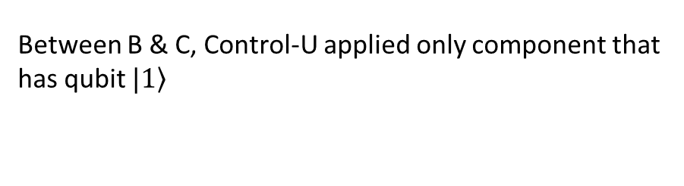
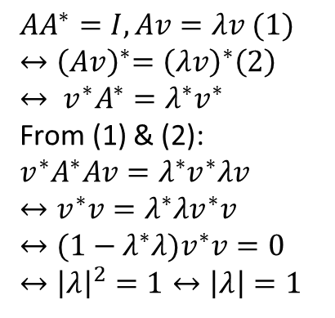
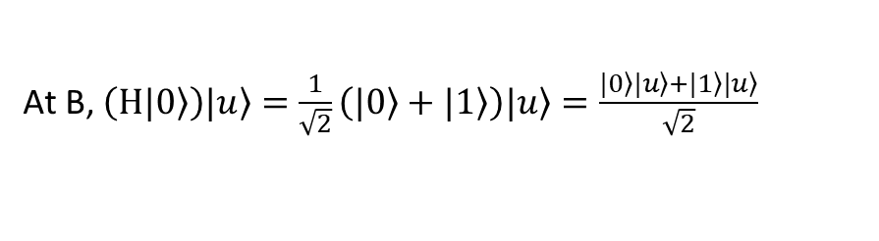
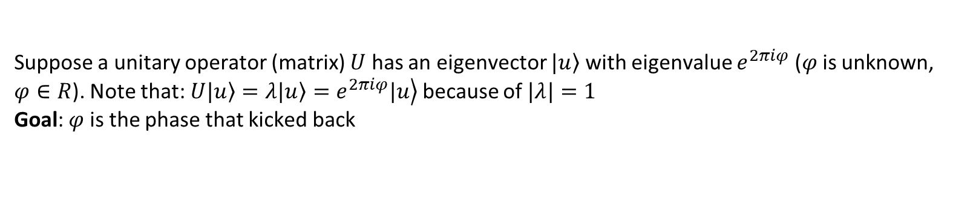
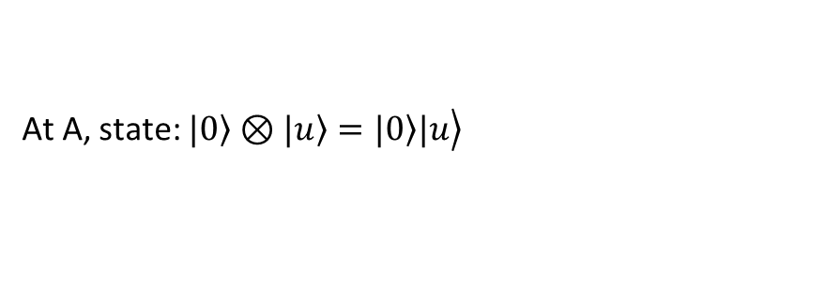
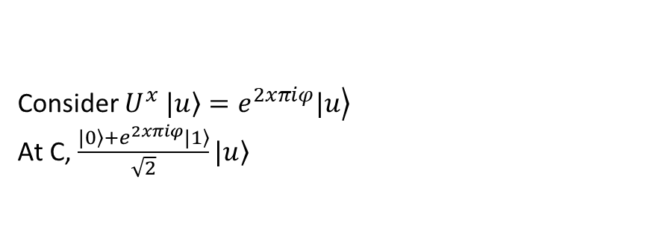
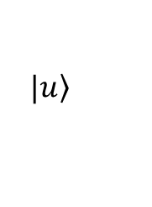
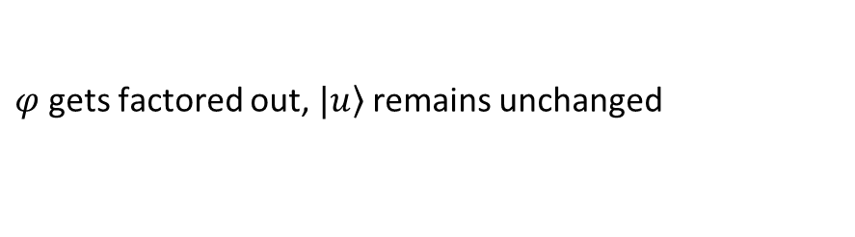
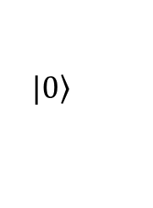
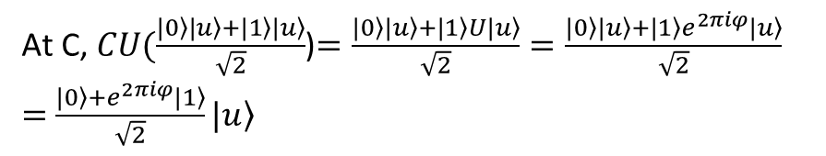
Suppose a unitary operator (matrix) $U$ has an eigenvector $\left.|u\right\rangle$ with eigenvalue $e^{2πiφ}$ ($φ$ is unknown, $φ∈R$). Note that: $U\left.|u\right\rangle =λ\left.|u\right\rangle =\left.e^{2πiφ}|u\right\rangle$ because of $|λ|=1$
Goal: $φ$ is the phase that kicked back
$$AA^{∗}=I, Av=λv (1)$$
$${↔\left(Av\right)}^{∗}={\left(λv\right)}^{∗}\left(2\right)$$
$$↔ {v^{∗}A}^{∗}=λ^{∗}v^{∗}$$
From (1) & (2):
$${v^{∗}A}^{∗}Av=λ^{∗}v^{∗}λv$$
$$↔v^{∗}v=λ^{∗}λv^{∗}v$$
$$↔(1−λ^{∗}λ)v^{∗}v=0$$
$$↔{\left|λ\right|}^{2}=1↔\left|λ\right|=1$$
$$\left.|0\right\rangle$$
H
control
M
$$\left.|u\right\rangle$$
U
target
A
B
C
At A, state: $\left.|0\right\rangle ⊗\left.|u\right\rangle =\left.\left.|0\right\rangle |u\right\rangle$
Consider $U^{x}$ $\left.|u\right\rangle =\left.e^{2xπiφ}|u\right\rangle$
At C, $\frac{\left.|0\right\rangle +e^{2xπiφ}\left.|1\right\rangle }{\sqrt{2}}\left.|u\right\rangle$
At B, $\left(H\left.|0\right\rangle \right)\left.|u\right\rangle =\frac{1}{\sqrt{2}}\left(\left.|0\right\rangle +\left.|1\right\rangle \right)\left.|u\right\rangle =\frac{\left.|0\right\rangle \left.|u\right\rangle +\left.|1\right\rangle \left.|u\right\rangle }{\sqrt{2}}$
Between B & C, Control-U applied only component that has qubit $\left.|1\right\rangle$
At C, $CU(\frac{\left.|0\right\rangle \left.|u\right\rangle +\left.|1\right\rangle \left.|u\right\rangle }{\sqrt{2}}$)$=\frac{\left.|0\right\rangle \left.|u\right\rangle +\left.|1\right\rangle U\left.|u\right\rangle }{\sqrt{2}}=\frac{\left.|0\right\rangle \left.|u\right\rangle +\left.|1\right\rangle e^{2πiφ}\left.|u\right\rangle }{\sqrt{2}}$
$=$ $\frac{\left.|0\right\rangle +e^{2πiφ}\left.|1\right\rangle }{\sqrt{2}}\left.|u\right\rangle$
$φ$ gets factored out, $\left.|u\right\rangle$ remains unchanged

Slide 7
2. Quantum Fourier Transform

Slide 8
5.1. Quantum Fourier transform
One of the most useful ways of solving a problem in mathematics or computer science is to transform it into some other problem for which a solution is known

Slide 9

5.1. Discrete Fourier transform
$$ℱ:ℂ^{n}→ℂ^{n}$$
Give a $N$ – dimensional complex vector $x=\left[\begin{matrix}x_{0} & … & x_{N−1}\end{matrix}\right]$
$ℱ\left(x\right)=y$ with $y_{k}=\frac{1}{\sqrt{N}}\sum_{j=0}^{N−1}{x_{j}e^{\frac{2πijk}{N}}=\frac{1}{\sqrt{N}}\sum_{j=0}^{N−1}{x_{j}ω_{N}^{jk}}}$

Slide 10

5.1. Quantum Fourier transform
$$ℱ:\left|j\right\rangle →\frac{1}{\sqrt{N}}\sum_{k=0}^{N−1}{ω_{N}^{jk}|k⟩}$$
Or the unitary matrix:
$${ℱ=U}_{QFT}=\frac{1}{\sqrt{N}}\sum_{j=0}^{N−1}{\sum_{k=0}^{N−1}{ω_{N}^{jk}|k⟩⟨j|}}$$

Slide 11
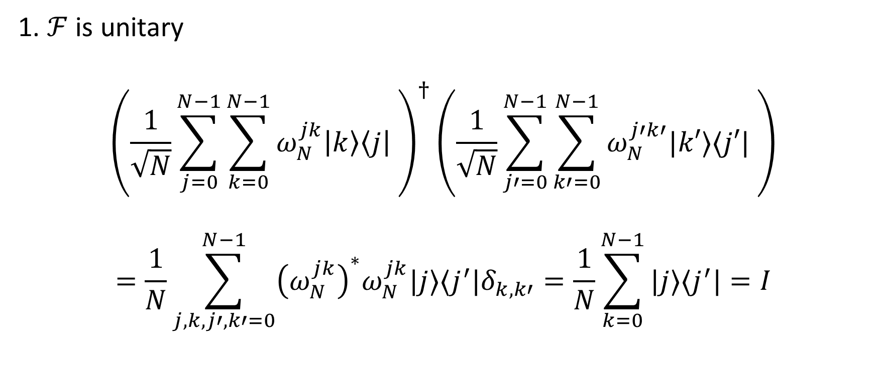
5.1. Quantum Fourier transform
1. $ℱ$ is unitary
$${\left(\frac{1}{\sqrt{N}}\sum_{j=0}^{N−1}{\sum_{k=0}^{N−1}{ω_{N}^{jk}\left|k\right\rangle \left\langle j\right|} }\right)}^{†}\left(\frac{1}{\sqrt{N}}\sum_{j′=0}^{N−1}{\sum_{k′=0}^{N−1}{ω_{N}^{j′k′}|k′⟩⟨j′|} }\right)$$
$$=\frac{1}{N}\sum_{j,k,j′,k′=0}^{N−1}{{\left(ω_{N}^{jk}\right)}^{∗}ω_{N}^{jk}|j⟩⟨j^{′}|δ_{k,k′}=\frac{1}{N}\sum_{k=0}^{N−1}{|j⟩⟨j^{′}|=I}}$$
Notes:
1 + 1 + … = N

Slide 12
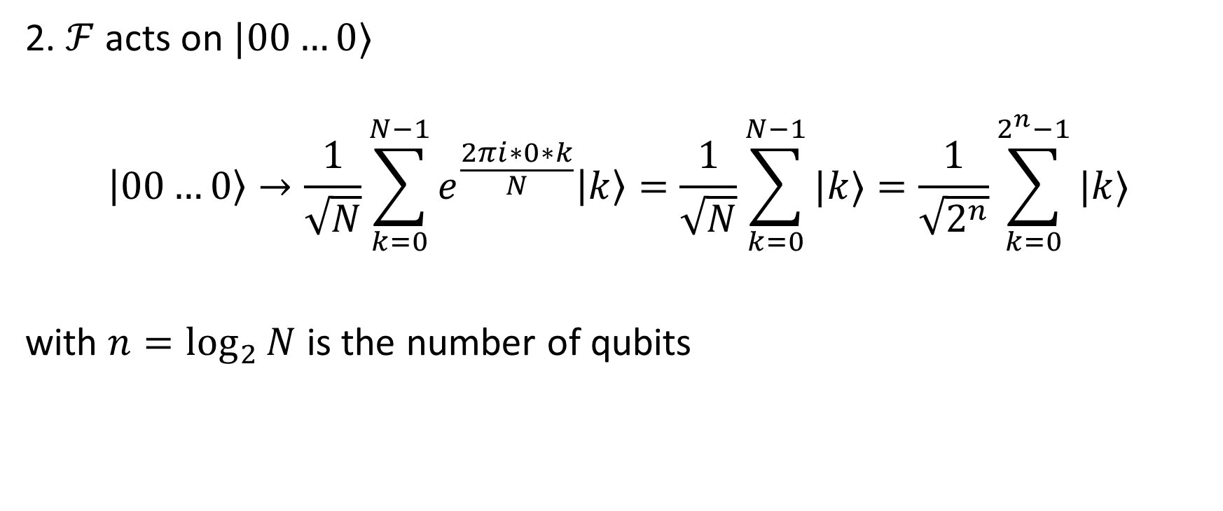
5.1. Quantum Fourier transform
2. $ℱ$ acts on $|00…0⟩$
$$\left|00…0\right\rangle →\frac{1}{\sqrt{N}}\sum_{k=0}^{N−1}{e^{\frac{2πi∗0∗k}{N}}\left|k\right\rangle =\frac{1}{\sqrt{N}}\sum_{k=0}^{N−1}{|k⟩}}=\frac{1}{\sqrt{2^{n}}}\sum_{k=0}^{2^{n}−1}{|k⟩}$$
with $n=\log_{2}{N}$ is the number of qubits

Slide 13

5.1. Quantum Fourier transform
Intuition:
$$ℱ:\left|State in computation basis\right\rangle →|State in Fourier basis⟩$$
$$U_{QFT}\left|x\right\rangle =|\tilde{x}⟩$$
$|\tilde{x}⟩$ denotes for the state in Fourier basis

Slide 14
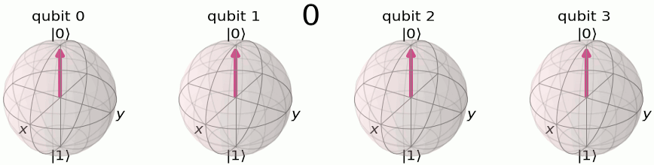
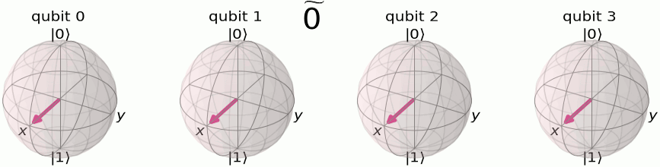
Computation basis
Fourier basis

Slide 15
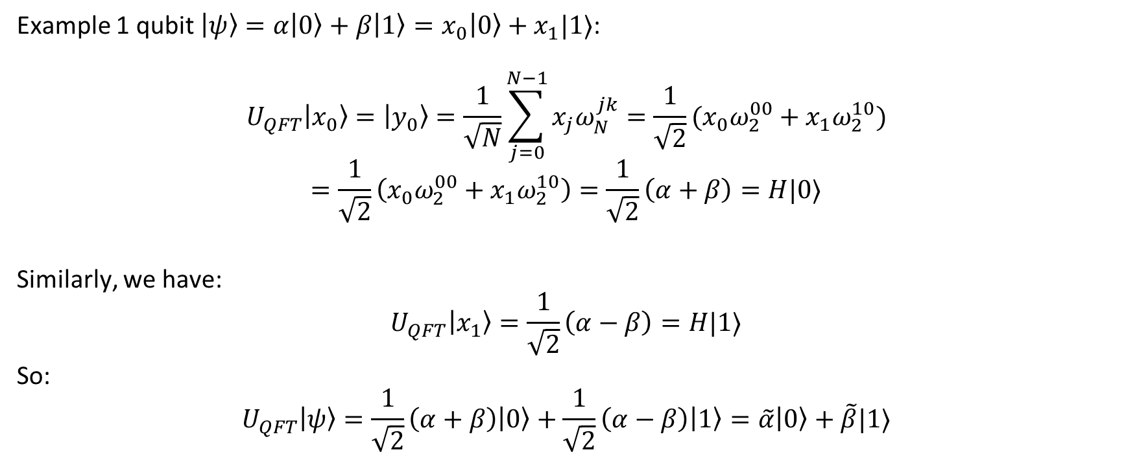
5.1. Quantum Fourier transform
Example 1 qubit $\left|ψ\right\rangle =α\left|0\right\rangle +β\left|1\right\rangle =x_{0}\left|0\right\rangle +x_{1}|1⟩$:
$$U_{QFT}\left|x_{0}\right\rangle =\left|y_{0}\right\rangle =\frac{1}{\sqrt{N}}\sum_{j=0}^{N−1}{x_{j}ω_{N}^{jk}}=\frac{1}{\sqrt{2}}(x_{0}ω_{2}^{00}+x_{1}ω_{2}^{10})$$
$$=\frac{1}{\sqrt{2}}\left(x_{0}ω_{2}^{00}+x_{1}ω_{2}^{10}\right)=\frac{1}{\sqrt{2}}\left(α+β\right)=H|0⟩$$
Similarly, we have:
$$U_{QFT}\left|x_{1}\right\rangle =\frac{1}{\sqrt{2}}\left(α−β\right)=H|1⟩$$
So:
$$U_{QFT}\left|ψ\right\rangle =\frac{1}{\sqrt{2}}\left(α+β\right)\left|0\right\rangle +\frac{1}{\sqrt{2}}\left(α−β\right)\left|1\right\rangle =\tilde{α}\left|0\right\rangle +\tilde{β}|1⟩$$

Slide 16
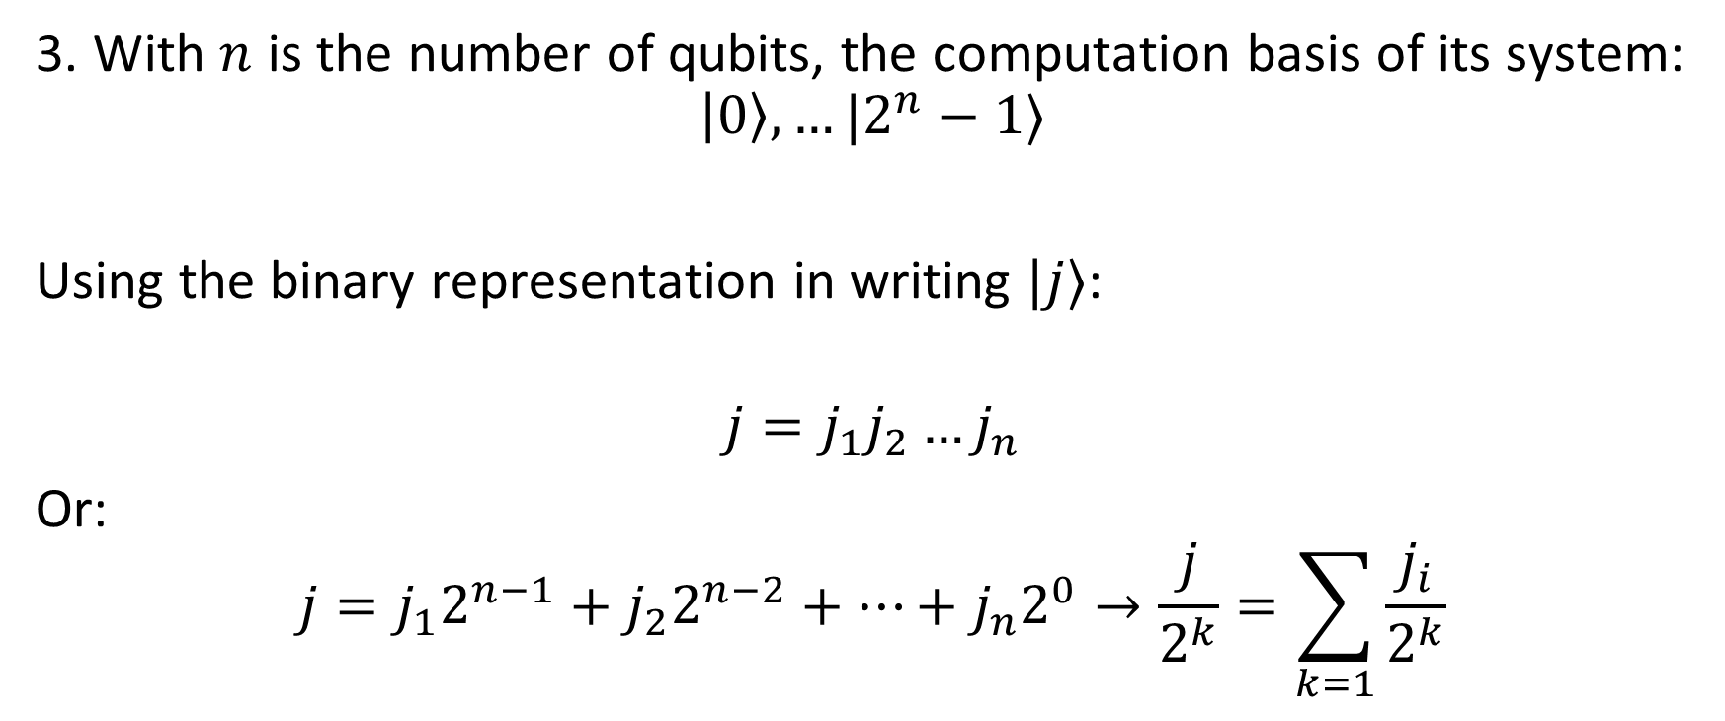
5.1. Quantum Fourier transform
3. With $n$ is the number of qubits, the computation basis of its system:
$$\left|0\right\rangle ,…|2^{n}−1⟩$$
Using the binary representation in writing $|j⟩$:
$$j=j_{1}j_{2}…j_{n}$$
Or:
$$j=j_{1}2^{n−1}+j_{2}2^{n−2}+…+j_{n}2^{0}→\frac{j}{2^{k}}=\sum_{k=1}{\frac{j_{i}}{2^{k}}}$$

Slide 17
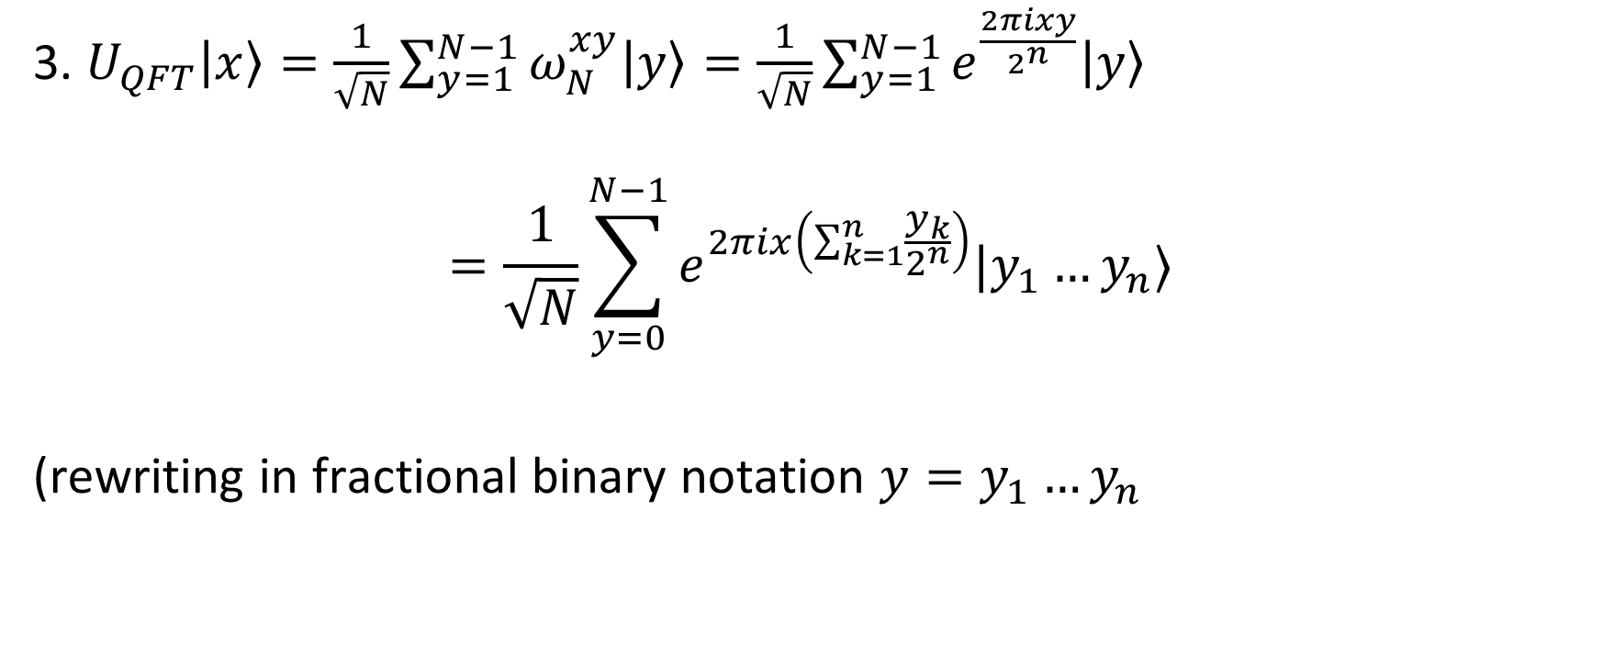
5.1. Quantum Fourier transform
3. $U_{QFT}\left|x\right\rangle =\frac{1}{\sqrt{N}}\sum_{y=1}^{N−1}{ω_{N}^{xy}\left|y\right\rangle =\frac{1}{\sqrt{N}}\sum_{y=1}^{N−1}{e^{\frac{2πixy}{2^{n}}}\left|y\right\rangle }}$
$$=\frac{1}{\sqrt{N}}\sum_{y=0}^{N−1}{e^{2πix\left(\sum_{k=1}^{n}{\frac{y_{k}}{2^{n}}}\right)}|y_{1}…y_{n}⟩}$$
(rewriting in fractional binary notation $y=y_{1}…y_{n}$

Slide 18
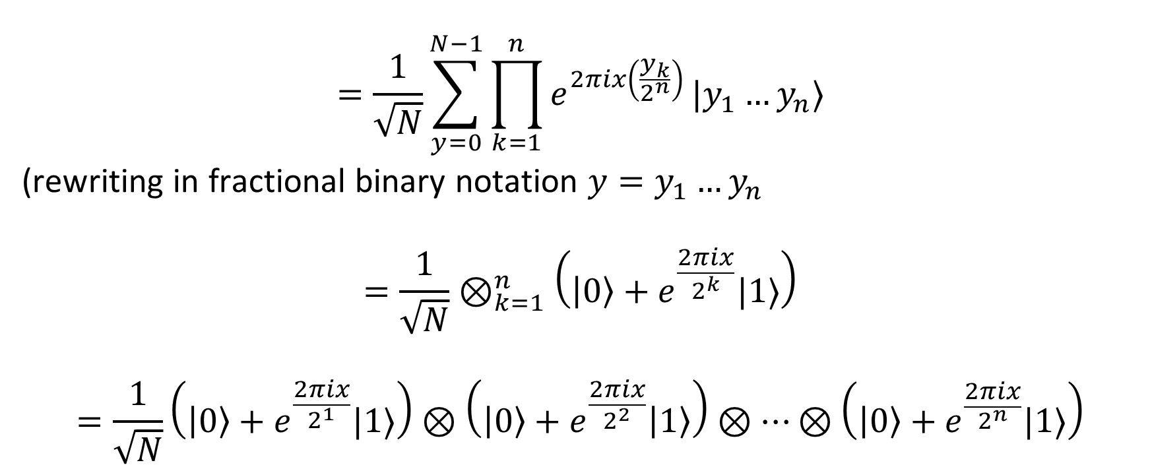
5.1. Quantum Fourier transform
$$=\frac{1}{\sqrt{N}}\sum_{y=0}^{N−1}{\prod_{k=1}^{n}{e^{2πix\left(\frac{y_{k}}{2^{n}}\right)}}|y_{1}…y_{n}⟩}$$
(rewriting in fractional binary notation $y=y_{1}…y_{n}$
$$=\frac{1}{\sqrt{N}}⊗_{k=1}^{n}\left(\left|0\right\rangle +e^{\frac{2πix}{2^{k}}}|1⟩\right)$$
$$=\frac{1}{\sqrt{N}}\left(\left|0\right\rangle +e^{\frac{2πix}{2^{1}}}|1⟩\right)⊗\left(\left|0\right\rangle +e^{\frac{2πix}{2^{2}}}\left|1\right\rangle \right)⊗…⊗\left(\left|0\right\rangle +e^{\frac{2πix}{2^{n}}}|1⟩\right)$$

Slide 19
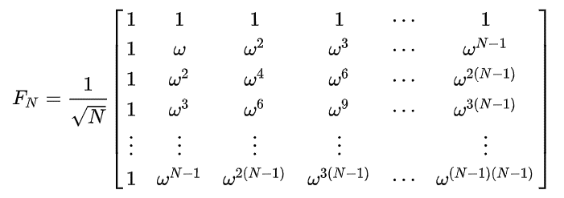
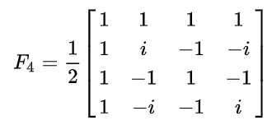
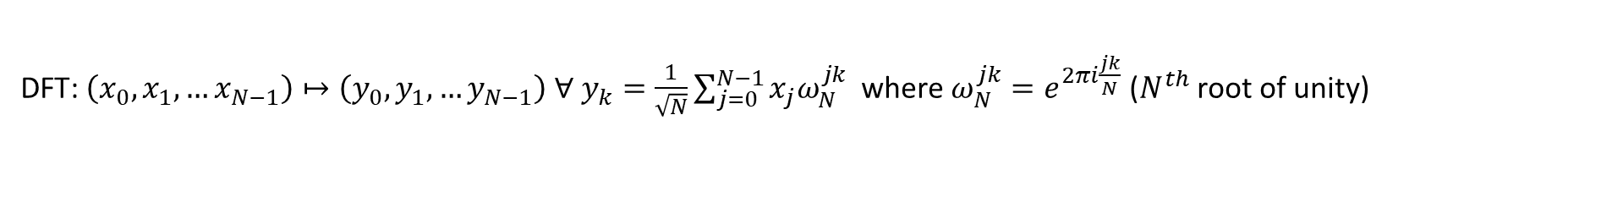
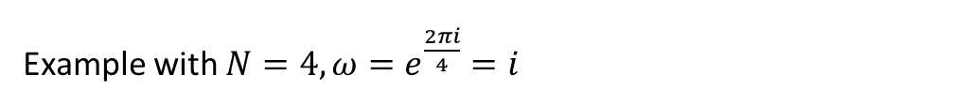
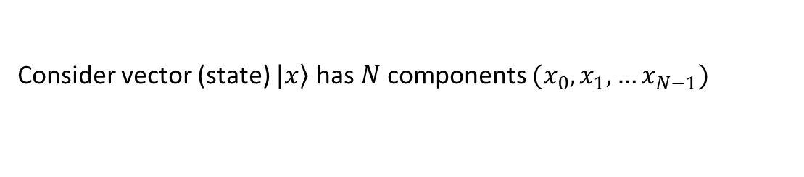
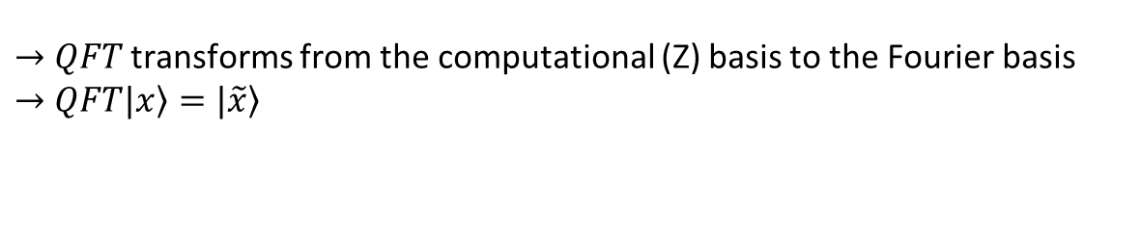
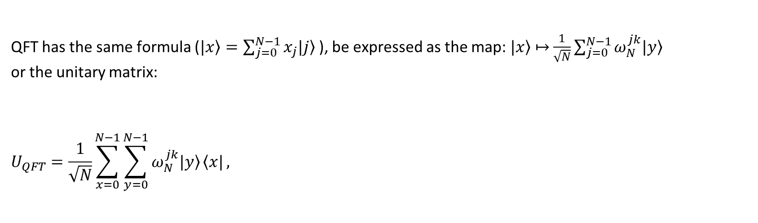
Consider vector (state) $\left.|x\right\rangle$ has $N$ components $(x_{0},x_{1},…x_{N−1})$
DFT: $\left(x_{0},x_{1},…x_{N−1}\right)↦\left(y_{0},y_{1},…y_{N−1}\right) ∀ y_{k}=\frac{1}{\sqrt{N}}\sum_{j=0}^{N−1}{x_{j}ω_{N}^{jk} }$ where $ω_{N}^{jk}=e^{2πi\frac{jk}{N}}$ ($N^{th}$ root of unity)
QFT has the same formula ($\left.|x\right\rangle =\sum_{j=0}^{N−1}{x_{j}\left.|j\right\rangle }$), be expressed as the map:$\left.|x\right\rangle$ $↦$ $\frac{1}{\sqrt{N}}\sum_{j=0}^{N−1}{ω_{N}^{jk}\left.|y\right\rangle }$
or the unitary matrix:
$$U_{QFT}=\frac{1}{\sqrt{N}}\sum_{x=0}^{N−1}{\sum_{y=0}^{N−1}{ω_{N}^{jk}\left.|y\right\rangle }\left\langle x|\right.},$$
Example with $N=4, ω=e^{\frac{2πi}{4}}=i$
$→$ $QFT$ transforms from the computational (Z) basis to the Fourier basis
$→$ $QFT\left.|x\right\rangle =\left.|\tilde{x}\right\rangle$

Slide 20
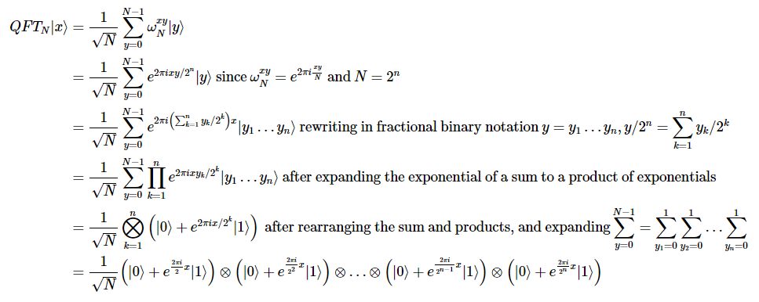

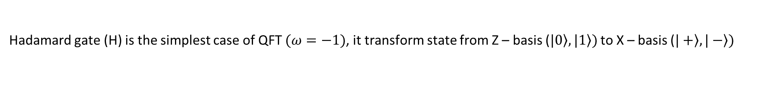
Hadamard gate (H) is the simplest case of QFT $(ω=−1)$, it transform state from Z – basis ($\left.|0\right\rangle ,\left.|1\right\rangle )$ to X – basis ($\left.|+\right\rangle ,\left.|−\right\rangle )$
Consider state $\left.|ψ\right\rangle =α\left.|0\right\rangle +β\left.|1\right\rangle$ ($x_{0}=α, x_{1}=β,N=2)$
$$y_{0}=\frac{1}{\sqrt{2}}\left(αe^{2πi\frac{0x0}{2}}+βe^{2πi\frac{1x0}{2}}\right)=\frac{1}{\sqrt{2}}(α+β)$$
$$y_{1}=\frac{1}{\sqrt{2}}\left(αe^{2πi\frac{0x1}{2}}+βe^{2πi\frac{1x1}{2}}\right)=\frac{1}{\sqrt{2}}(α−β)$$
$$U_{QFT}\left.|ψ\right\rangle =\frac{1}{\sqrt{2}}\left(α+β\right)\left.|0\right\rangle +\frac{1}{\sqrt{2}}\left(α−β\right)\left.|1\right\rangle$$

Slide 21
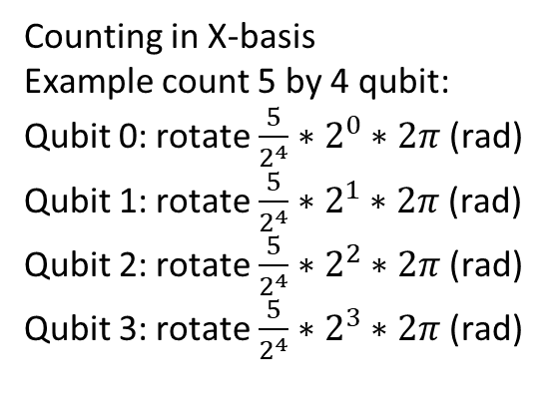
What QFT used for?
Counting in Z-basis seems like to classical computing
Counting in X-basis
Example count 5 by 4 qubit:
Qubit 0: rotate $\frac{5}{2^{4}}∗2^{0}∗2π$ (rad)
Qubit 1: rotate $\frac{5}{2^{4}}∗2^{1}∗2π$ (rad)
Qubit 2: rotate $\frac{5}{2^{4}}∗2^{2}∗2π$ (rad)
Qubit 3: rotate $\frac{5}{2^{4}}∗2^{3}∗2π$ (rad)

Slide 22
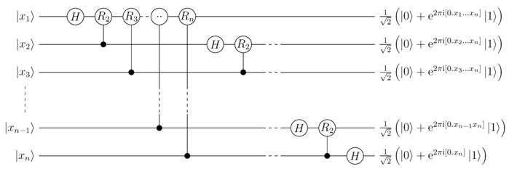
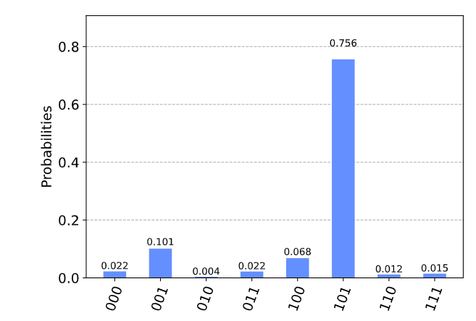
Read out the phases

Slide 23
3. Quantum Phase Estimation

Slide 24
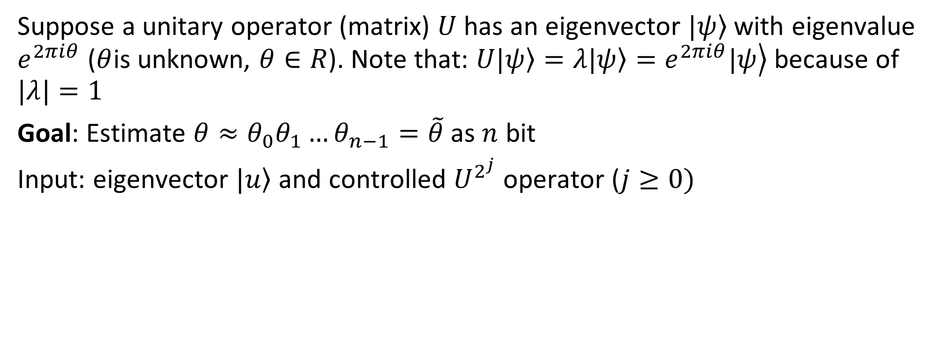
Suppose a unitary operator (matrix) $U$ has an eigenvector $\left.|ψ\right\rangle$ with eigenvalue $e^{2πiθ}$ ($θ$is unknown, $θ∈R$). Note that: $U\left.|ψ\right\rangle =λ\left.|ψ\right\rangle =\left.e^{2πiθ}|ψ\right\rangle$ because of $|λ|=1$
Goal: Estimate $θ≈θ_{0}θ_{1}…θ_{n−1}=\tilde{θ}$ as $n$ bit
Input: eigenvector $\left.|u\right\rangle$ and controlled $U^{2^{j}}$ operator ($j≥0)$

Slide 25
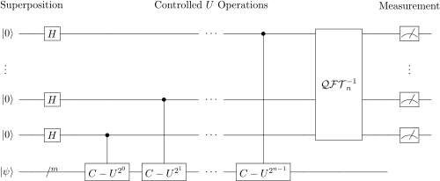
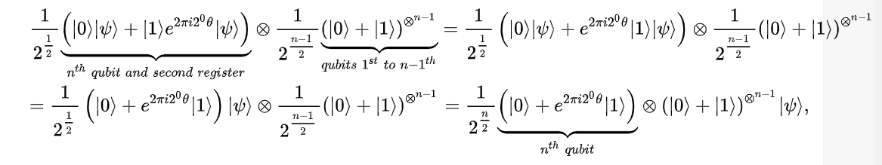
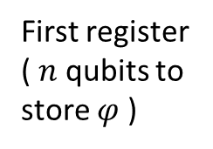
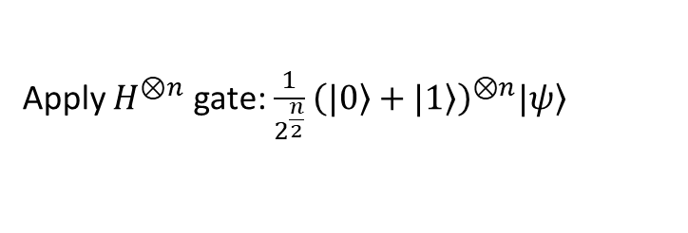
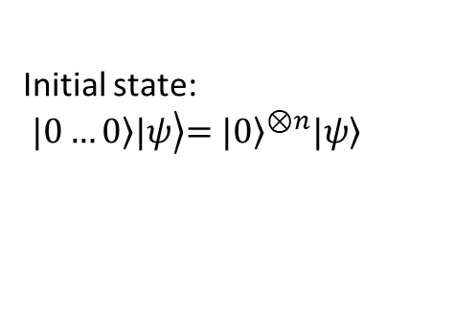
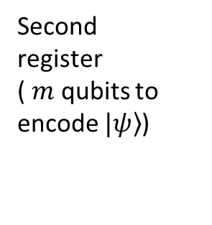
Initial state:
$$\left.\left.|0…0\right\rangle |ψ\right\rangle {\left.=|0\right\rangle }^{⊗n}\left.|ψ\right\rangle$$
First register
( $n$ qubits to store $φ$ )
Second register
( $m$ qubits to encode $\left.|ψ\right\rangle$)
Apply $H^{⊗n}$ gate:$\frac{1}{2^{\frac{n}{2}}}{\left(\left.|0\right\rangle +\left.|1\right\rangle \right)}^{⊗n}\left.|ψ\right\rangle$
Apply controlled unitary operations

Slide 26
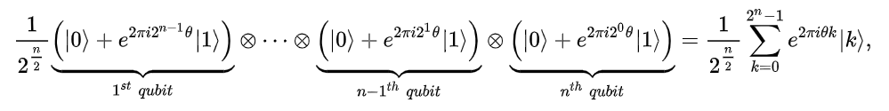
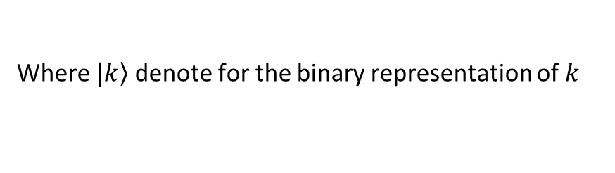
Initial state:
$$\left.\left.|0…0\right\rangle |ψ\right\rangle {\left.=|0\right\rangle }^{⊗n}\left.|ψ\right\rangle$$
First register
( $n$ qubits to store $φ$ )
Second register
( $m$ qubits to encode $\left.|ψ\right\rangle$)
Apply controlled unitary operations
Where $\left.|k\right\rangle$ denote for the binary representation of $k$

Slide 27
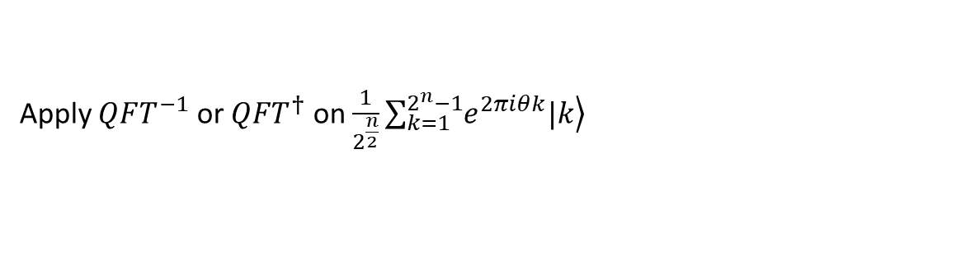
Initial state:
$$\left.\left.|0…0\right\rangle |ψ\right\rangle {\left.=|0\right\rangle }^{⊗n}\left.|ψ\right\rangle$$
First register
( $n$ qubits to store $φ$ )
Second register
( $m$ qubits to encode $\left.|ψ\right\rangle$)
Apply $QFT^{−1}$ or $QFT^{†}$ on $\frac{1}{2^{\frac{n}{2}}}\sum_{k=1}^{2^{n}−1}{\left.e^{2πiθk}|k\right\rangle }$
Yields:

Slide 28
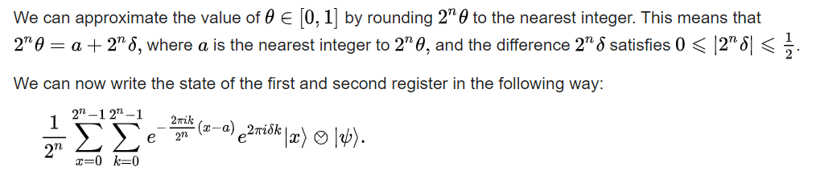
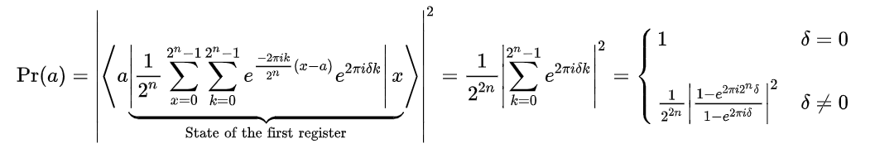

Slide 29
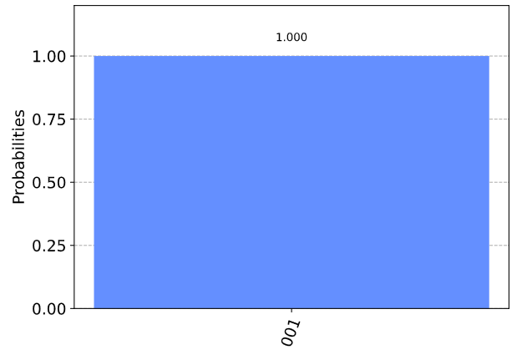
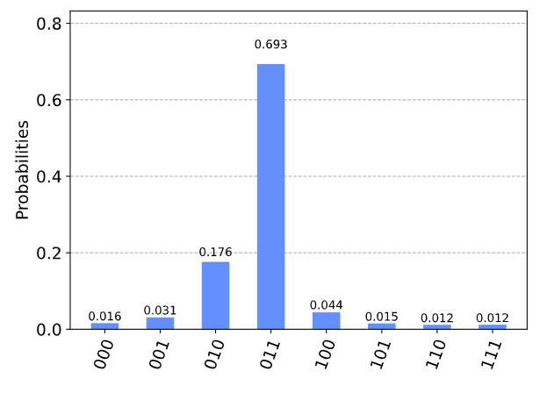

When $θ=\frac{{001}_{2}}{2^{n}}=1/8$
we see our most likely results are 010(bin) = 2(dec) and 011(bin) = 3(dec). These two results would tell us that θ = 0.25 (off by 25%) and θ = 0.375 (off by 13%) respectively

Slide 30
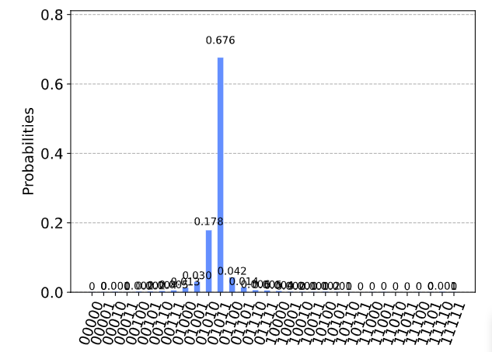

The two most likely measurements are now 01011 (decimal 11) and 01010 (decimal 10). Measuring these results would tell us $θ$ is:
$θ=\frac{11}{2^{5}}=0.344,θ=\frac{10}{2^{5}}=0.3$13

Slide 31
Solving large linear system of equations by HHL Algorithm
20/2/2021

Slide 32

1. Introduction
Give: $\left\{\begin{aligned}x_{1}−\frac{x_{2}}{3}=1 \\ −\frac{x_{1}}{3}+x_{2}=0\end{aligned}\right.(A=\left[\begin{matrix}1 & −\frac{1}{3} \\ −\frac{1}{3} & 1\end{matrix}\right], \left.|b\right\rangle =\left[\begin{matrix}1 \\ 0\end{matrix}\right],\left.|x\right\rangle =\left[\begin{matrix}x_{1} \\ x_{2}\end{matrix}\right]$)
$⇒A\left.|x\right\rangle =\left.|b\right\rangle$. Assume $A$ is Hermitian, $A=\sum_{j=0}^{N−1}{λ_{j}}\left.|u_{j}\right\rangle \left\langle u_{j}|\right., λ_{j}∈ℝ$
($u_{j}$ is the $j^{th}$ eigenvector and $λ_{j}$ is the $j^{th}$ eigenvalue, respectively)

Slide 33

1. Introduction
Example:
$A=\left[\begin{matrix}−2 & 1 \\ 1 & 2\end{matrix}\right]$, $λ_{1}=−3,λ_{2}=2,v_{1}=\left[\begin{matrix}−\frac{2}{\sqrt{5}} \\ \frac{1}{\sqrt{5}}\end{matrix}\right],v_{2}=\left[\begin{matrix}\frac{1}{\sqrt{5}} \\ \frac{2}{\sqrt{5}}\end{matrix}\right]$
$$A=λ_{1}v_{1}v_{1}^{∗}+λ_{2}v_{2}v_{2}^{∗}=−3\left[\begin{matrix}−\frac{2}{\sqrt{5}} \\ \frac{1}{\sqrt{5}}\end{matrix}\right]\left[\begin{matrix}−\frac{2}{\sqrt{5}} & \frac{1}{\sqrt{5}}\end{matrix}\right]+2\left[\begin{matrix}\frac{1}{\sqrt{5}} \\ \frac{2}{\sqrt{5}}\end{matrix}\right]\left[\begin{matrix}\frac{1}{\sqrt{5}} & \frac{2}{\sqrt{5}}\end{matrix}\right]$$

Slide 34

1. Introduction
Then:
$$A^{−1}=\sum_{j=0}^{N−1}{λ_{j}^{−1}}\left.|u_{j}\right\rangle \left\langle u_{j}|\right., \left.|b\right\rangle =\sum_{j=0}^{N−1}{b_{j}}\left.|u_{j}\right\rangle$$
$$⇒\left.|x\right\rangle =A^{−1}\left.|b\right\rangle =\sum_{j=0}^{N−1}{{λ_{j}^{−1}b}_{j}}\left.|u_{j}\right\rangle$$

Slide 35



2. HHL Algorithm
Load eigenvalue of $A$
Ancilla bit
Load $\left.|b\right\rangle$

Slide 36



3. Run on qiskit
Approximate t
Norm 2 between 2 solutions
Exactly t

Slide 37




1. 3 GB RAM
3.9 GB RAM
$$RAM≈0.5 ∗ 2^{\frac{N}{2}} (GB)$$
$$EX_{TIME}≈x∗2^{\frac{N}{2}} (s)$$

Slide 38


5000 x 5000 matrix solving by classical computer
5000 x 5000 matrix solving by quantum simulation require:
$$RAM≈0.5 ∗ 2^{\frac{log2(5000)}{2}} (GB)=35 (GB)$$
$$EX_{TIME}≈x∗2^{\frac{\log{2\left(5000\right)}}{2}} \left(s\right)$$

Slide 39
Summary HHL
Quantum phase estimation (QPE)
Phase kickback
Quantum Fourier transform (QFT)
Inverse of QPE

Slide 40

Questions
1. What ancilla qubits used for?
Store output
Padding for higher order gate with use less component than normal

Slide 41
Questions
How many iterations needed?
Common time?
The relationship between size of input (n) and number of qubits

Slide 42
Quantum search algothrithm
By Lov Grover 1995

Slide 43


1. Problem
Given an unordered array of $m$ elements, find a particular element $x$.
Classical: brute-force requires $m$ queries (average $\frac{m}{2}$)
Quantum: grover’s algothrithm requires $√m$

Slide 44


Slide 45

2. Algothrithm
Imagine that you are given a function $f:{\left\{0, 1\right\}}^{n}→\{0, 1\}$and you are assured that there exists exactly one binary string $x_{0}$ such that:
$$f_{0}=\left\{\begin{aligned}1,if x=x_{0} \\ 0, if x≠x_{0}\end{aligned}\right.$$
Assume $f$ is a unitary matrix $U_{f}$ that take $\left.|x,y\right\rangle$ to $\left.|x,f(x)⊕y\right\rangle$

Slide 46


2. Algothrithm
$$n=2, x_{0}=10$$

Slide 47


2. Algothrithm

Slide 48



3. Example
$$N=3, x_{0}=101$$
Initial state: (1)
After apply $H^{⊕N}$ (2):

Slide 49


3. Example
After apply Phase inversion: (3a)
Calculate average of all elements in $\left.|φ_{3a}\right\rangle$ (3a)

Slide 50




Slide 51




3. Example (iteration 1)
$$→$$
After phase inversion

Slide 52





3. Example (iteration 2)
Remember that we need to repeat step 3 $√(2^{n})$ to achieve state $\left.|φ_{3b}\right\rangle$
$$→$$

Slide 53


3. Example
$$→$$
Measure:
$$p\left(\left.|101\right\rangle \right)={\left(\frac{11}{4\sqrt{8}}\right)}^{2}=0.9453=94.53\%$$
$$p\left(\left.|other\right\rangle \right)=\frac{{\left(\frac{−1}{4\sqrt{8}}\right)}^{2}}{7}=0.0078=0.78\%$$

Slide 54


Slide 55




$$x_{0}=101 \& 110$$

Slide 56


Excute on real device
$$x_{0}=0110 \& 1001$$

Slide 57
Quantum walk
4/3/2022
Vu Tuan Hai

Slide 58



Random walk
Take the random variable $Z∈\{−1, 1\}$
The series ${\{S}_{n}\}$ is a 1-D random walk with $S_{0}=0$ and $S_{n}=\sum_{i=1}^{n}{Z_{i}}$

Slide 59


Random walk
Values of ${\{S}_{N}\}$
Normal distribution of $S_{N}$
More likely
Unlikely

Slide 60




Quantum walk (using superposition)
Incre $↑$
Decre $↓$
$$\left|000\right\rangle →\left|001\right\rangle$$
$$\left|010\right\rangle →|011⟩$$
…
H
$$\left|↑\right\rangle ⊗\left|0\right\rangle \underset{→}{H}\frac{1}{\sqrt{2}}(|↑ ⟩+|↓ ⟩)⊗|0⟩\underset{→}{S}\frac{1}{\sqrt{2}}(|↑ ⟩|0⟩+|↓ ⟩⊗|0⟩)$$

Slide 61







Incre $↑$
Decre $↓$
PREP
$${PREP}^{†}$$
$${\left|0\right\rangle }^{⊗n}$$
SELECT
$$\left|000\right\rangle →\left|001\right\rangle$$
$$\left|010\right\rangle →|011⟩$$
…
H
$$|ψ⟩$$
(a)
(b)

Slide 62



Quantum walk
Values of ${\{S}_{N}\}$
Paranormal distribution of $S_{N}$
Unlikely
More likely

Slide 63
Quantum walk
Quantum walk is described as product of 2 unitary operator: coin flip operator & shift operator

Slide 64


1. Spatial search (discrete time)
1
Assume that we have a complete graph with 4 nodes.
One approach is using random walk.
Note that:
Walker must be in somewhere
$$⇒\sum{P_{j}=1}$$
4
2
3

Slide 65





2. Random walk
$$\frac{1}{4}$$
1
Initial state: ¼ at all node
At step k: jump to other random nodes
$P_{1}=P_{2}=P_{3}=P_{4}=1/4$
Acts as absorb node
$$\frac{1}{4}$$
4
2
$$\frac{1}{4}$$
3
$$\frac{1}{4}$$

Slide 66










2. Random walk
$$\frac{1}{12}$$
$$\frac{1}{12}$$
1
At step 1:
$$\frac{1}{12}$$
$$\frac{1}{12}$$
$$\frac{1}{12}$$
4
2
$$\frac{1}{4}$$
$$\frac{1}{12}$$
$$\frac{1}{12}$$
3
$$\frac{1}{12}$$
$$\frac{1}{12}$$

Slide 67





2. Random walk
$$\frac{1}{6}$$
1
When done step 1:
$$P_{1}=P_{3}=P_{4}=\frac{1}{12}∗2 =\frac{1}{6}$$
$$P_{2}=\frac{1}{4}+\frac{1}{12}∗3=1/2$$
$$\frac{1}{6}$$
4
2
$$\frac{1}{2}$$
3
$$\frac{1}{6}$$

Slide 68









2. Random walk
$$\frac{1}{18}$$
$$\frac{1}{18}$$
1
At step 2:
$$\frac{1}{18}$$
$$\frac{1}{18}$$
$$\frac{1}{18}$$
4
2
$$\frac{1}{2}$$
$$\frac{1}{18}$$
$$\frac{1}{18}$$
3
$$\frac{1}{18}$$
$$\frac{1}{18}$$

Slide 69





2. Random walk
$$\frac{1}{9}$$
1
When done step 2:
$P_{1}=P_{3}=P_{4}=\frac{1}{18}∗2=\frac{1}{9}$
$$P_{2}=\frac{1}{2}+\frac{1}{18}∗3=\frac{2}{3}$$
$$\frac{1}{9}$$
4
2
$$\frac{2}{3}$$
3
$$\frac{1}{9}$$

Slide 70









2. Random walk
$$\frac{1}{27}$$
$$\frac{1}{27}$$
1
At step 3:
$$\frac{1}{27}$$
$$\frac{1}{27}$$
$$\frac{1}{27}$$
4
2
$$\frac{2}{3}$$
$$\frac{1}{27}$$
$$\frac{1}{27}$$
3
$$\frac{1}{27}$$
$$\frac{1}{27}$$

Slide 71





2. Random walk
$$\frac{2}{27}$$
1
When done step 3:
$$P_{1}=P_{3}=P_{4}=\frac{1}{27}∗2=\frac{2}{27}$$
$$P\left(2\right)=\frac{2}{3}+\frac{1}{27}∗3=\frac{7}{9}$$
$$\frac{2}{27}$$
4
2
$$\frac{7}{9}$$
3
$$\frac{2}{27}$$

Slide 72


2. Random walk
Prob(Success) at time t = $1−\frac{N−1}{N}{\left(\frac{N−2}{N−1}\right)}^{t}$
Runtime: $O(N)$

Slide 73













3. Quantum walk
$$α_{14}$$
1
$$α_{12}$$
Change 4 probs to 12 amplitudes of a wave function $\left|ψ\right\rangle ≔\{α_{i}\}$
Init: $|ψ(0)⟩$
Note that at intermediate steps we cannot observe the system. Then we do not know the current node is the marked node or not.
$$α_{41}$$
$$α_{21}$$
$$α_{13}$$
4
2
$$α_{42}$$
$$α_{24}$$
$$α_{31}$$
$$α_{43}$$
$$α_{23}$$
3
$$α_{34}$$
$$α_{32}$$

Slide 74














3. Quantum walk
At node 2: A = $\frac{−1}{\sqrt{12}}∗\frac{3}{3}$
$$\frac{1}{\sqrt{12}}$$
$$\frac{1}{\sqrt{12}}$$
1
At step 1
1a. Query oracle:
$$Q|ψ\left(0\right)⟩$$
1b. Apply a quantum coin flip+shift (-I+2A) that inverts each amplitude about the average amplitude at its vertex. (Nothing happen)
$$C(Q|ψ\left(0\right)⟩)$$
$$\frac{1}{\sqrt{12}}$$
$$−\frac{1}{\sqrt{12}}$$
$$\frac{1}{\sqrt{12}}$$
$$\frac{1}{\sqrt{12}}$$
$$−\frac{1}{\sqrt{12}}$$
2
4
$$\frac{1}{\sqrt{12}}$$
$$\frac{1}{\sqrt{12}}$$
$$−\frac{1}{\sqrt{12}}$$
3
$$\frac{1}{\sqrt{12}}$$
$$\frac{1}{\sqrt{12}}$$

Slide 75







3. Quantum walk
$$\frac{1}{\sqrt{12}}$$
$$−\frac{1}{\sqrt{12}}$$
1
1c. Shift operator (walk): walker at vertex i pointing to vertex j to hop to vertex j and point back to vertex i $⇒$ Swap $α_{ij}$ with $α_{ji}$.
$$SCQ\left|ψ\left(0\right)\right\rangle =|ψ\left(1\right)⟩$$
$$\frac{1}{\sqrt{12}}$$
$$\frac{1}{\sqrt{12}}$$
$$−\frac{1}{\sqrt{12}}$$
$$\frac{1}{\sqrt{12}}$$
$$\frac{1}{\sqrt{12}}$$
2
4
$$\frac{1}{\sqrt{12}}$$
$$\frac{1}{\sqrt{12}}$$
$$\frac{1}{\sqrt{12}}$$
3
$$\frac{1}{\sqrt{12}}$$
$$−\frac{1}{\sqrt{12}}$$

Slide 76

3. Quantum walk
$$\frac{1}{\sqrt{12}}$$
$$−\frac{1}{\sqrt{12}}$$
1
At step 2
2a. Query oracle:
$$Q|ψ\left(1\right)⟩$$
$$\frac{1}{\sqrt{12}}$$
$$−\frac{1}{\sqrt{12}}$$
$$−\frac{1}{\sqrt{12}}$$
$$\frac{1}{\sqrt{12}}$$
$$−\frac{1}{\sqrt{12}}$$
2
4
$$\frac{1}{\sqrt{12}}$$
$$\frac{1}{\sqrt{12}}$$
$$−\frac{1}{\sqrt{12}}$$
3
$$\frac{1}{\sqrt{12}}$$
$$−\frac{1}{\sqrt{12}}$$

Slide 77


3. Quantum walk
Reflected amp
2b. The coin inverts or reflects each amplitude about their average.
(-I+2A)
At node 1: $A=\frac{\frac{1}{\sqrt{12}}+\frac{1}{\sqrt{12}}−\frac{1}{\sqrt{12}}}{3}=\frac{1}{6\sqrt{3}}$
$$⇒α_{12}=−α_{12}+2A=\frac{5}{6\sqrt{3}}$$
$$⇒α_{13}=−α_{13}+2A=\frac{−1}{6\sqrt{3}}$$
Current amp

Slide 78













3. Quantum walk
$$\frac{−1}{6\sqrt{3}}$$
$$\frac{5}{6\sqrt{3}}$$
1
2c. Shift operator (walk): swap $α_{ij}$ with $α_{ji}$.
$$\frac{−1}{6\sqrt{3}}$$
$$−\frac{1}{2\sqrt{3}}$$
$$\frac{−1}{6\sqrt{3}}$$
$$−\frac{1}{2\sqrt{3}}$$
4
2
$$\frac{5}{6\sqrt{3}}$$
$$\frac{−1}{6\sqrt{3}}$$
$$\frac{−1}{6\sqrt{3}}$$
$$−\frac{1}{2\sqrt{3}}$$
3
$$\frac{−1}{6\sqrt{3}}$$
$$\frac{5}{6\sqrt{3}}$$

Slide 79











3. Quantum walk
$$\frac{11}{108}$$
$$\frac{−1}{6\sqrt{3}}$$
$$−\frac{1}{2\sqrt{3}}$$
1
2c. Shift operator (walk): swap $α_{ij}$ with $α_{ji}$.
$$\frac{−1}{6\sqrt{3}}$$
$$\frac{5}{6\sqrt{3}}$$
$$−\frac{1}{2\sqrt{3}}$$
$$\frac{−1}{6\sqrt{3}}$$
$$\frac{5}{6\sqrt{3}}$$
2
$$\frac{11}{108}$$
4
$$\frac{25}{36}$$
$$\frac{−1}{6\sqrt{3}}$$
$$\frac{−1}{6\sqrt{3}}$$
$$\frac{5}{6\sqrt{3}}$$
3
$$\frac{−1}{6\sqrt{3}}$$
$$−\frac{1}{2\sqrt{3}}$$
$$\frac{11}{108}$$

Slide 80




3. Quantum walk
Prob(Success) at time t =
Runtime: $O(\sqrt{N})$
N=4
N=100

Slide 81


References
Thomas Wong,
Creighton University

